Slide 1


GROUP: BUMBLEBEE
Anomaly Detection in Network Traffic using a Transformer Autoencoder

Slide 2
TEAM MEMBERS
Alexios C Papazoglou
Geetika Khanna
Mohit Saluru
Pragati Rao

Slide 3
PROBLEM & MOTIVATION
Challenge: DDoS attacks threaten online services; traditional supervised methods fail against zero-day attacks
Innovation: Reframe DDoS detection as sequence reconstruction problem using Transformer autoencoders
Advantage: Detect both known and novel attacks by learning only from benign traffic patterns

Slide 4
DATASET & SCALE
CIC-DDoS2019 Dataset: 50+ million network flow records with 84 features
Extreme Imbalance: Only 0.11% benign traffic (56,863 samples) vs 99.89% attacks
Processing: Transformed into 56,326 sequences of 100 timesteps each for training and testing

Slide 5
DATA PREPROCESSING
To handle the dataset's massive size, we developed a memory-safe, chunk-based processing pipeline.
Extracted only benign flows for autoencoder training
Dropped rows with missing or infinite values to ensure data integrity
Timestamp normalized to seconds since start of capture
Created overlapping sequences of 100 time steps (sliding window)
Final dataset shape: 56,326 samples × 100 timesteps × 84 features
Preprocessed data stored as .npy for fast loading during training
Ensured consistent scale across features using StandardScaler normalization.
Additionally, created different .npy files for 12 different attack vectors.

Slide 6
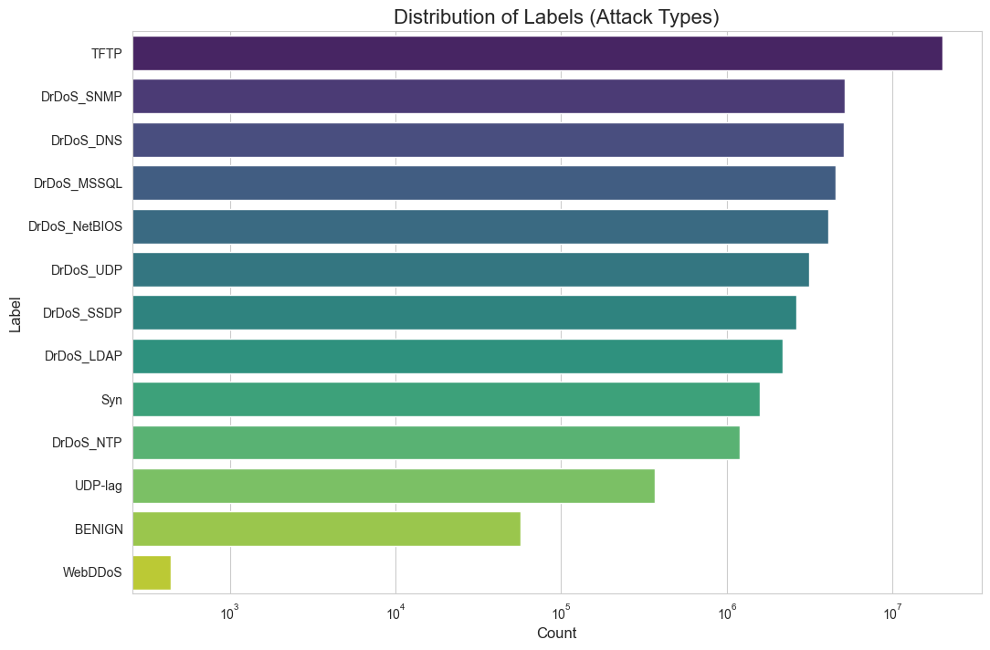
DATA VISUALIZATIONS
Severe Class Imbalance
Benign traffic is only 0.11% of the dataset, validating our unsupervised approach.

Slide 7
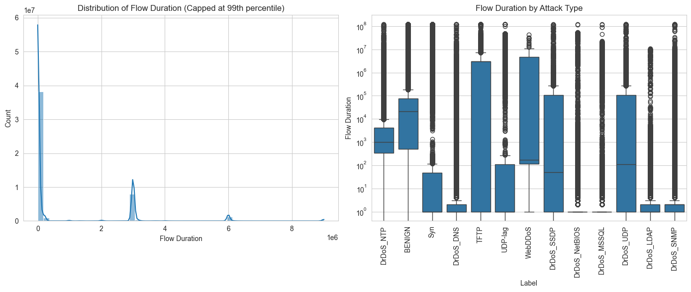
DATA VISUALIZATIONS
Distribution of Flow Duration

Slide 8
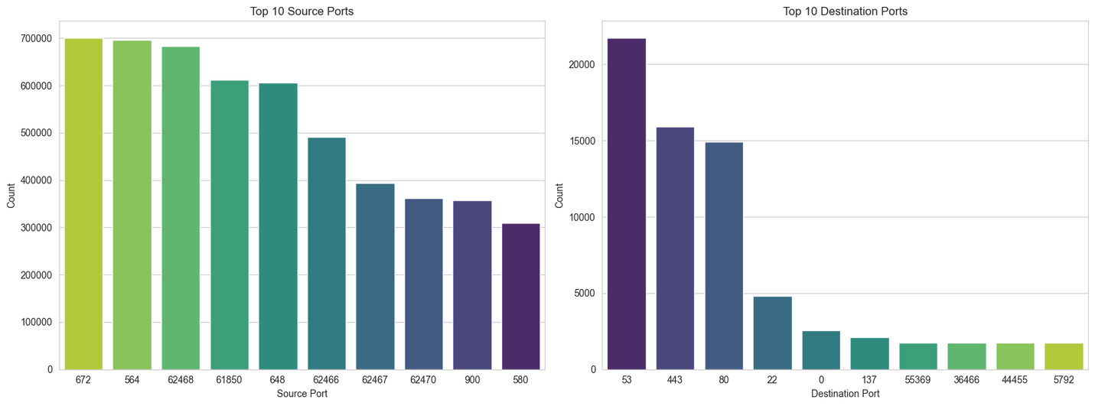
DATA VISUALIZATIONS
Top 10 Source and Destination Ports

Slide 9
OUR SOLUTION : A THREE-PART STRATEGY
We tackled this with a robust engineering and modeling pipeline:
Part 1 - Scalable Data Processing: We engineered a memory-safe, chunk-based pipeline that can process terabyte-scale datasets on a standard machine. (This was a major challenge we solved.)
Part 2 - Unsupervised Learning: We trained a Transformer Autoencoder to become an expert on "normal" behavior, allowing it to spot anything that deviates.
Part 3 - Explainable AI (XAI): Our model doesn't just raise an alarm; it shows a security analyst where to look via attention heatmaps.

Slide 10
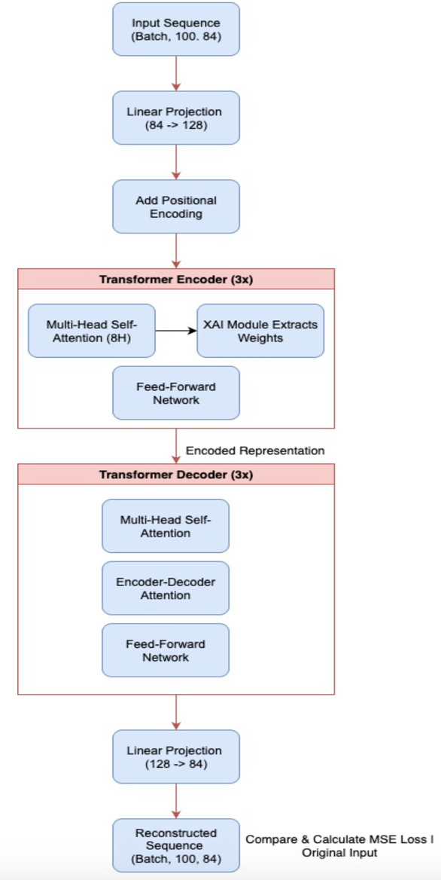
MODEL OVERVIEW & CORE INNOVATION
Input Projection: A linear layer projects the input features of each time step to the model's internal dimension (d_model=128).
Positional Encoding: Sinusoidal positional encodings are added to the input to give the model information about the order of time steps in a sequence.
Encoder: A stack of 3 Transformer Encoder layers, each containing a Multi-Head Self-Attention module (8 heads) and a Position-wise Feed-Forward Network.
Decoder: A stack of 3 Transformer Decoder layers that takes the encoder's output (the compressed representation) and attempts to reconstruct the original input sequence.
Output Projection: A final linear layer projects the decoder's output back to the original feature dimension.

Slide 11
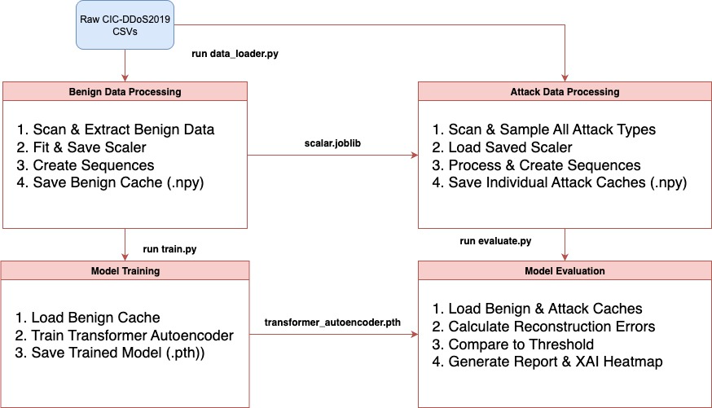
ARCHITECTURE DATA FLOW
Data Processing Parameters:
SEQUENCE_LENGTH = 100
Model Hyperparameters:
INPUT_FEATURES = 84
MODEL_DIM = 128
NUM_HEADS = 8
NUM_ENCODER_LAYERS = 3
DIM_FEEDFORWARD = 512
DROPOUT = 0.1
Training Hyperparameters:
LEARNING_RATE = 0.0001
BATCH_SIZE = 64
NUM_EPOCHS = 20

Slide 12
DEMO

Slide 13
TOOLS AND TECHNOLOGIES USED
Programming Language: Python
Deep Learning Framework: PyTorch
Data Manipulation: Pandas, NumPy, PyArrow
Machine Learning & Preprocessing: Scikit-learn, Joblib
Visualization: Matplotlib, Seaborn

Slide 14
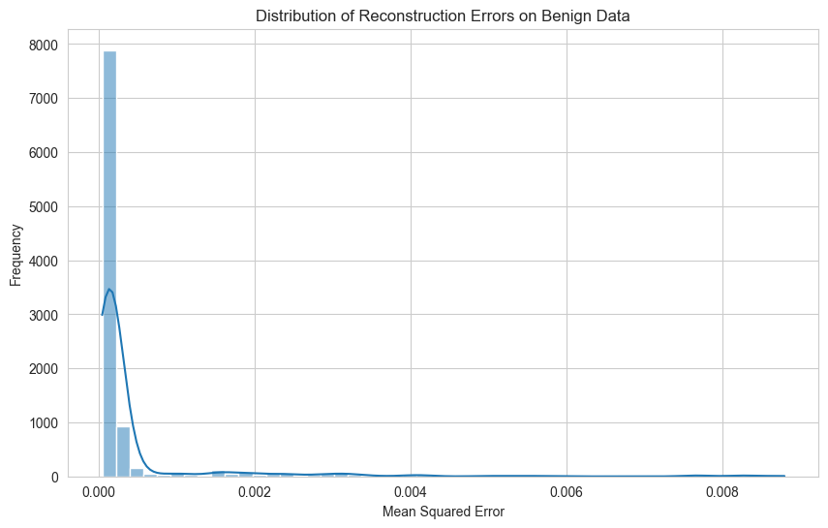
EVALUATION
The model was evaluated using two distinct test sets. The anomaly threshold was set at the 99th percentile of reconstruction errors on a benign validation set.

Slide 15
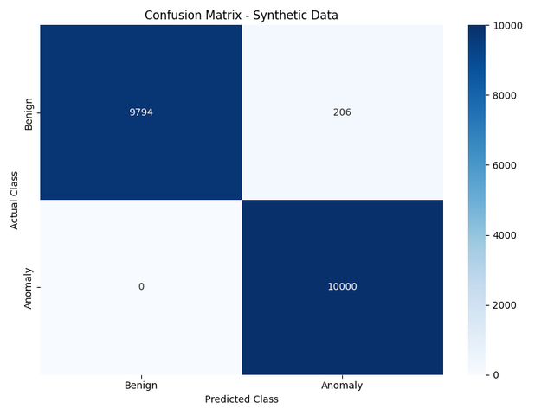
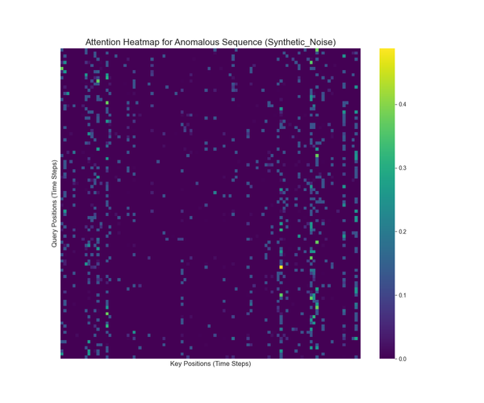
EVALUATION
Test1: Synthetic Data (Noise)
Overall Accuracy: 98.97%
Metrics for 'Anomaly' class:
Precision: 97.98%
Recall: 100.00%
F1-Score: 98.98%
Insight: The near-perfect score confirms the model is excellent at detecting simple statistical deviations but is not a true measure of its ability to detect structured attacks.
 | Precision | Recall | F1 Score | Support
Benign | 1.00 | 0.98 | 0.99 | 10000
Anomaly | 0.98 | 1.00 | 0.99 | 10000
Accuracy |  |  | 0.99 | 20000
Macro Avg. | 0.99 | 0.99 | 0.99 | 20000
Weighted Avg. | 0.99 | 0.99 | 0.99 | 20000
CLASSIFICATION REPORT

Slide 16

EVALUATION
Test 2: Combined Real Attack Data This test used a combined dataset containing samples from all 12 real attack types found in the dataset.
Overall Accuracy: 99.73%
Metrics for 'Anomaly' class:
Precision: 99.46%
Recall: 100.00%
F1-Score: 99.73%
 | Precision | Recall | F1 Score | Support
Benign | 1.00 | 0.99 | 1.00 | 619926
Anomaly | 0.99 | 1.00 | 1.00 | 619926
Accuracy |  |  | 1.00 | 1239852
Macro Avg. | 1.00 | 1.00 | 1.00 | 1239852
Weighted Avg. | 1.00 | 1.00 | 1.00 | 1239852
CLASSIFICATION REPORT

Slide 17
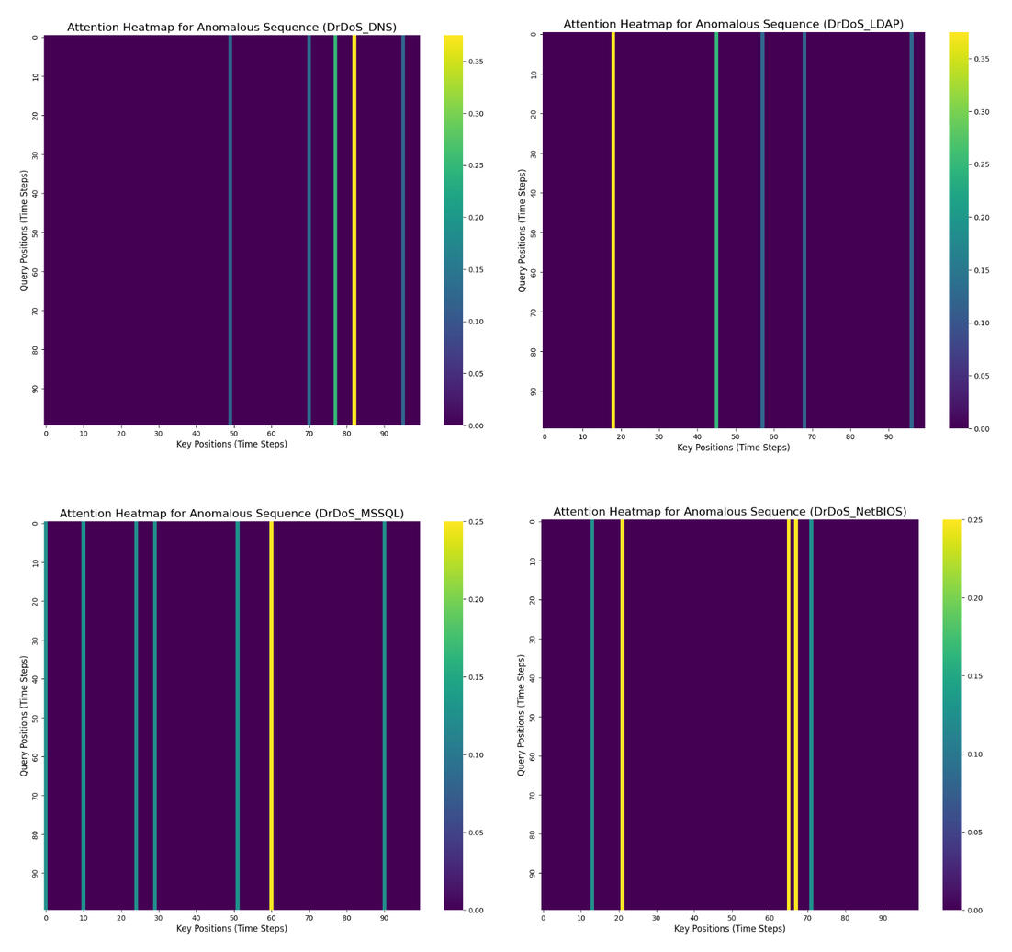
EVALUATION - ATTACK HEATMAPS

Slide 18
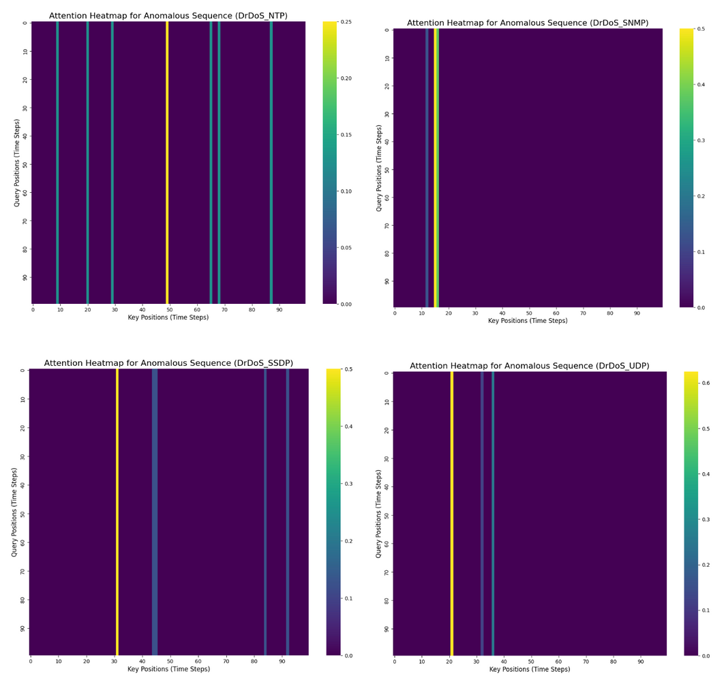
EVALUATION - ATTACK HEATMAPS

Slide 19
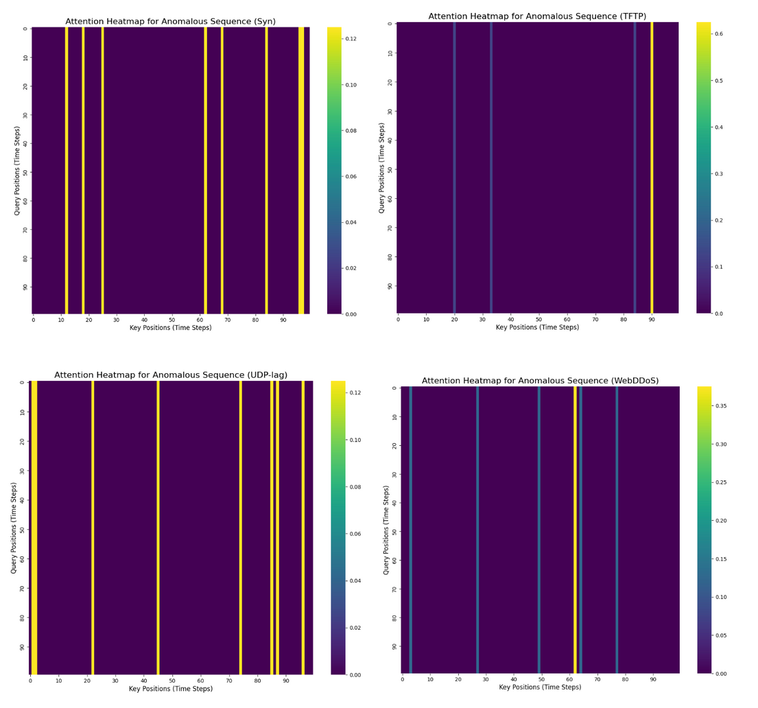
EVALUATION - ATTACK HEATMAPS

Slide 20
ADVANTAGES & APPLICATIONS
Key Advantages:
Handles Zero-Day Attacks with Unsupervised Learning
Scalable to Real-World Data
Explainable: Attention heatmaps show decision rationale
Extensible: Support for multi-scale attention and VAE uncertainty modeling
Flexible: Plug-and-play decoder options (Transformer/GRU)
Applications:
Network intrusion detection
IoT sensor anomaly detection
Financial fraud detection
Industrial equipment monitoring

Slide 21
COMPARISON TO SOTA
Feature | Our Model (Transformer Autoencoder) | SOTA Model (Anomaly Transformer)
Core Mechanics | Learns to reconstruct normal (benign) time-series data. High reconstruction error indicates an anomaly. | Learns prior associations and series associations in time-series data to calculate an "association discrepancy."
Primary Goal | Effective detection AND practical explainability for security operations. | Highest possible detection accuracy on academic benchmarks.
Time Series Data Handling | Yes (Native). The entire architecture is built around learning temporal patterns in sequences. | Yes (Native). Specifically designed for time-series data.
Explainability AI (XAI) | Key Advantage: Integrated. Generates attention heatmaps to show why a sequence is anomalous. | Limited. While attention weights can be inspected, it's not a primary feature.
Scalability | Key Advantage: Proven. The data pipeline is explicitly designed to be memory-safe for massive datasets. | High. Transformers are generally scalable but the implementation may not be optimized for out-of-core data.
Novelty/ Key Advantages | Practicality & Insight. Combines high accuracy with a robust data pipeline and actionable XAI results. | Theoretical Performance. A novel "association discrepancy" mechanism designed to push accuracy limits.
F1-Score | 99.73% | 94.96%

Slide 22
INSIGHTS & LIMITATIONS
Insights:
Realistic Testing is Crucial: The high accuracy of >99% on real attack data demonstrates that simple noise injection is an inadequate proxy for real-world threats.
Scalability Solved: The chunk-based data processing pipeline is a critical contribution, making it feasible to work with datasets that far exceed available RAM.
XAI Provides Value: The attention heatmaps successfully provide a first step towards understanding the model's reasoning, moving it from a "black box" to an interpretable security tool.
Limitations:
Static Threshold: The fixed anomaly threshold may not adapt well to natural, long-term shifts in network behavior (concept drift).
Computational Cost: The one-time caching of attack data is still a time-consuming (though memory-safe) process.

Slide 23
CONCLUSION & FUTURE WORK
Summary: We successfully built a highly accurate, unsupervised anomaly detection system and, just as importantly, developed a scalable data pipeline that makes working with massive security datasets feasible.
Key Takeaway: Our work highlights that realistic evaluation is critical for building trustworthy security models.
Future Work:
Dynamic Thresholding: Adapt the anomaly threshold to changing network conditions.
Attack Classification: Extend the model to identify the type of attack.
Real-Time Deployment: Integrate the system for live network monitoring.

Slide 24
CITATIONS
Papers:
Xu, J., et al. (2022). "Anomaly Transformer: Time Series Anomaly Detection with Association Discrepancy." International Conference on Learning Representations (ICLR).
Vaswani, A., et al. (2017). "Attention Is All You Need." NeurIPS.
Datasets:
Sharafaldin, I., Lashkari, A. H., & Ghorbani, A. A. (2019). "Intrusion Detection in the Era of Big Data: A CIC-DDoS2019 Dataset." Canadian Institute for Cybersecurity (CIC). Retrieved from https://www.unb.ca/cic/datasets/ddos-2019.html.
Tools & Libraries:
Paszke, A., et al. (2019). "PyTorch: An Imperative Style, High-Performance Deep Learning Library." Advances in Neural Information Processing Systems.
The pandas development team. (2020). "pandas-dev/pandas: Pandas." Zenodo.
Pedregosa, F., et al. (2011). "Scikit-learn: Machine Learning in Python." Journal of Machine Learning Research.

Slide 25
THANK
YOU

